Slide 1
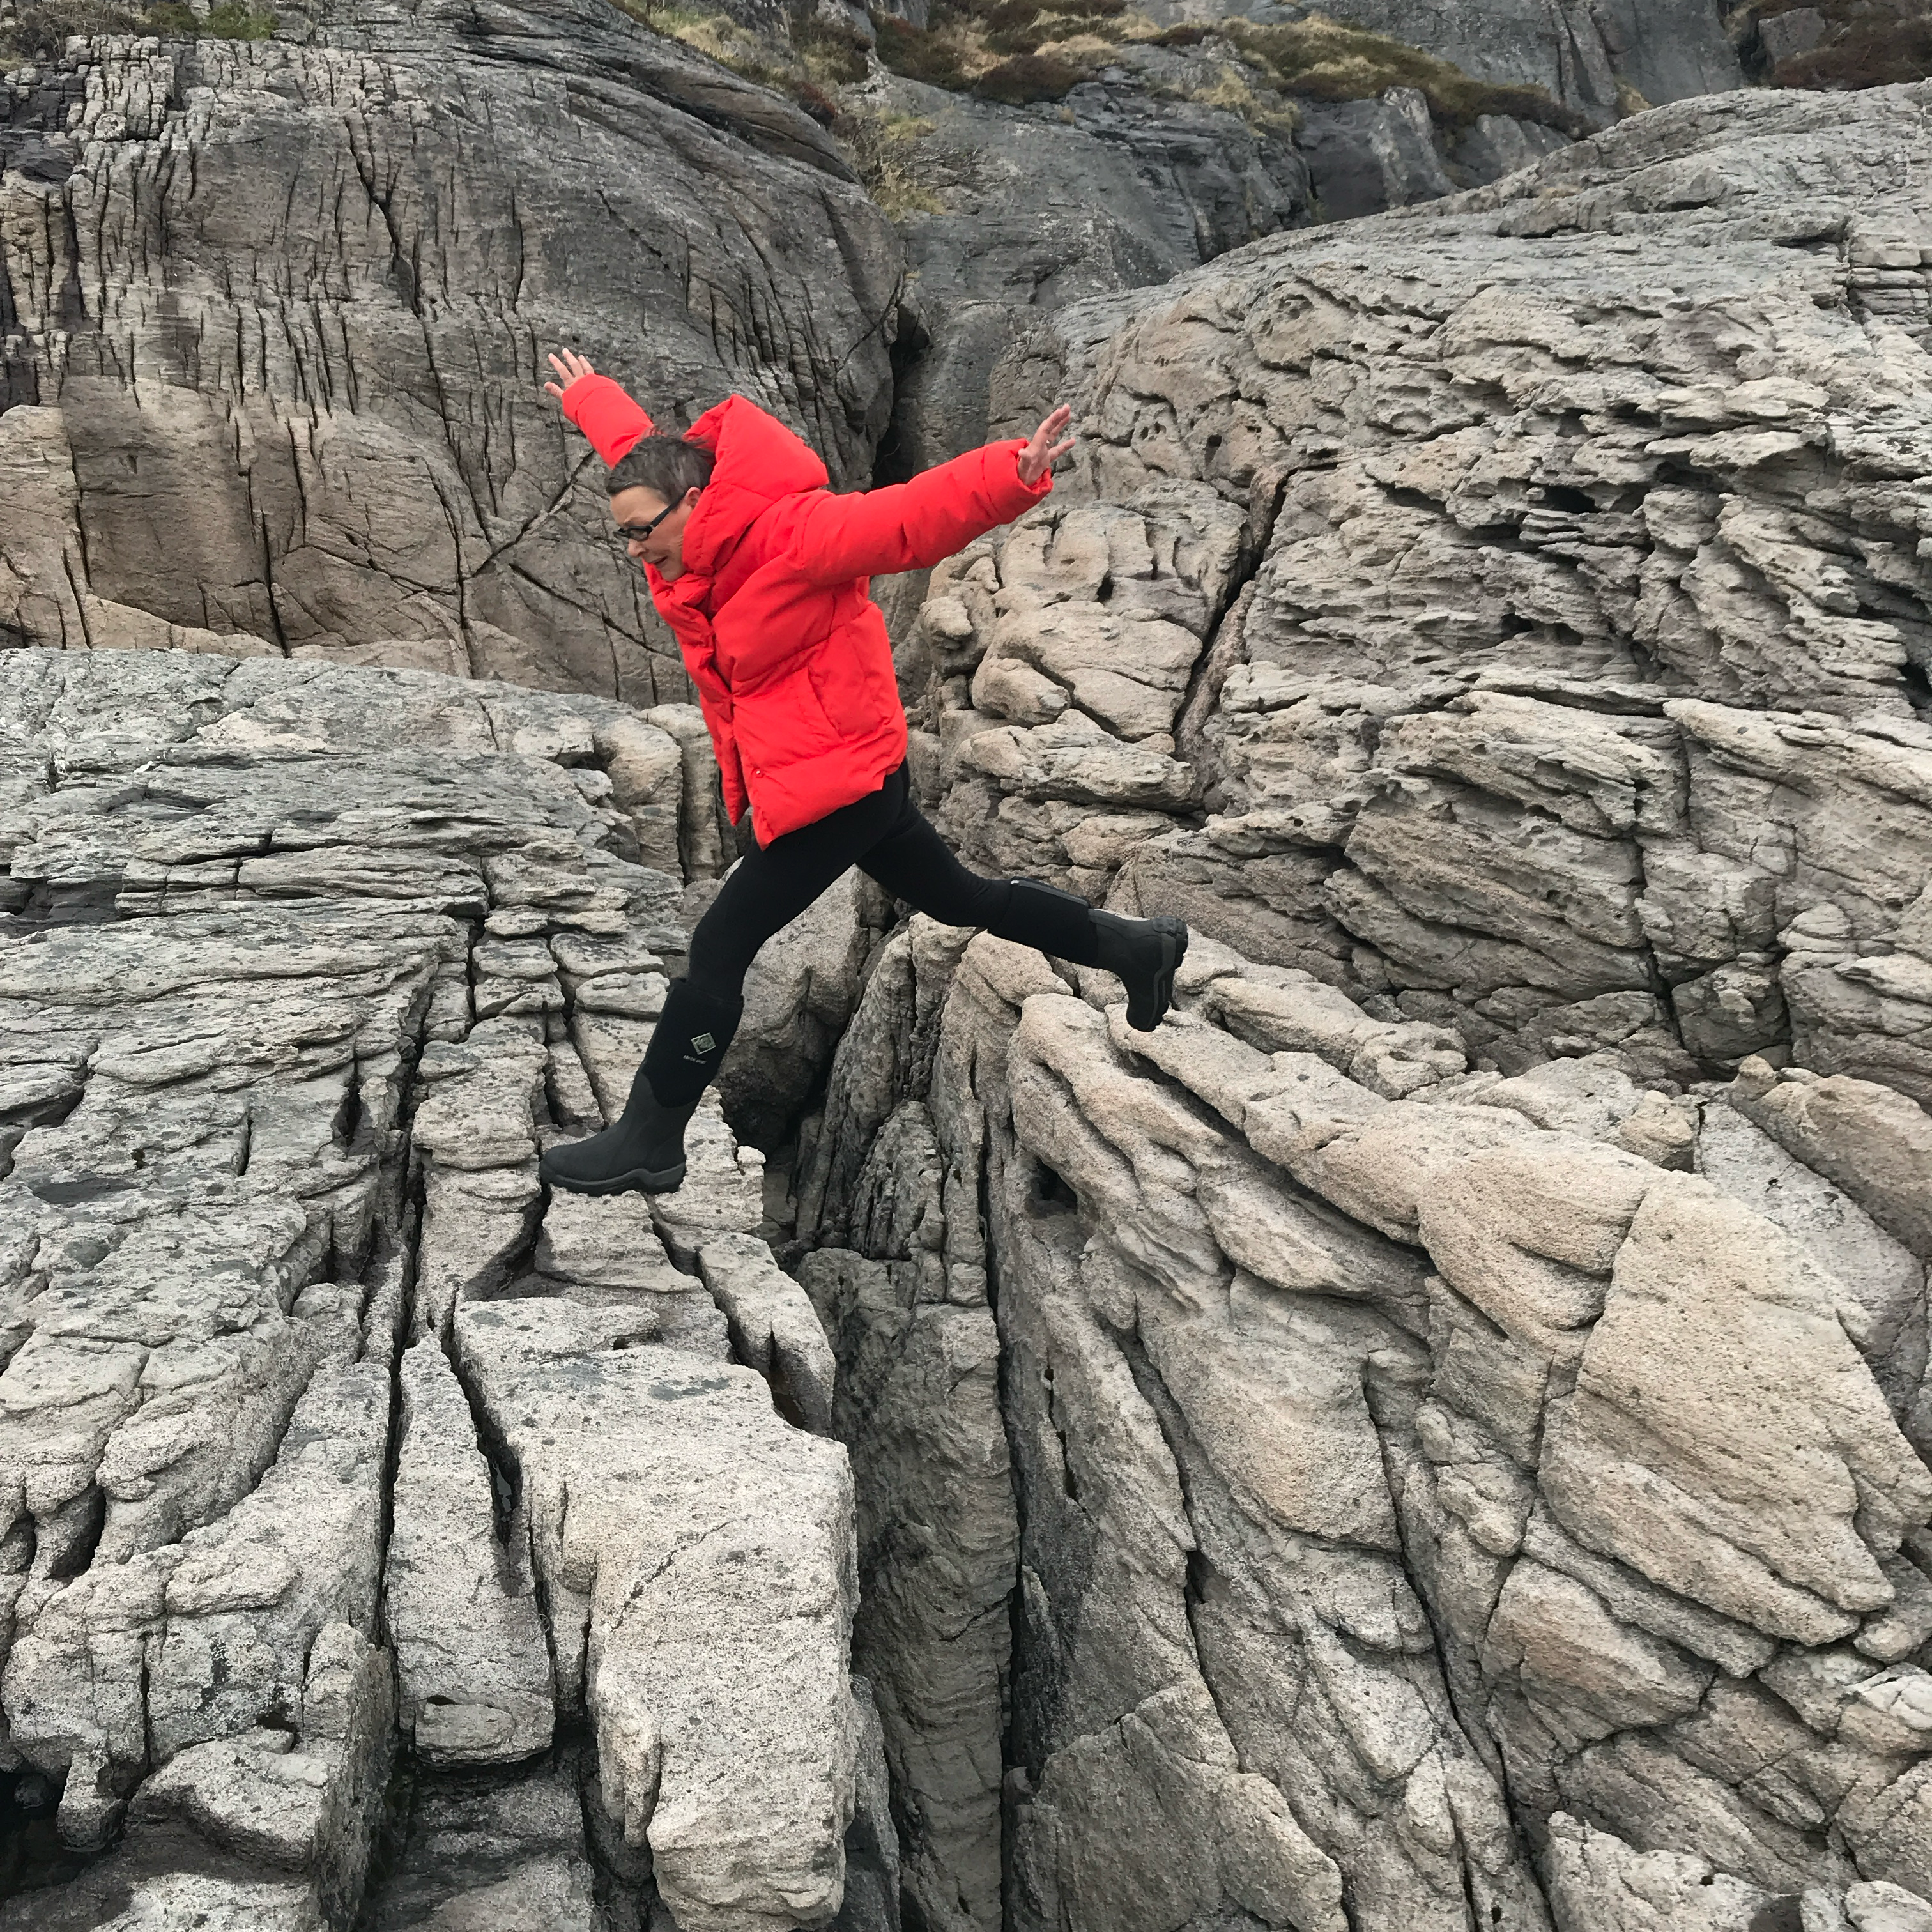
Designs un-filtered — a real-world view, or
there’s more than meets the eye
EUIPO IP Law Conference 20 May 2026
Päivi Tahkokallio
CEO Tahkokallio Design+
Former President of BEDA, The Bureau of European Design Associations
Director of Proto2026 Design Programme

Slide 2

15 May 2026, Lake Inari

Slide 3
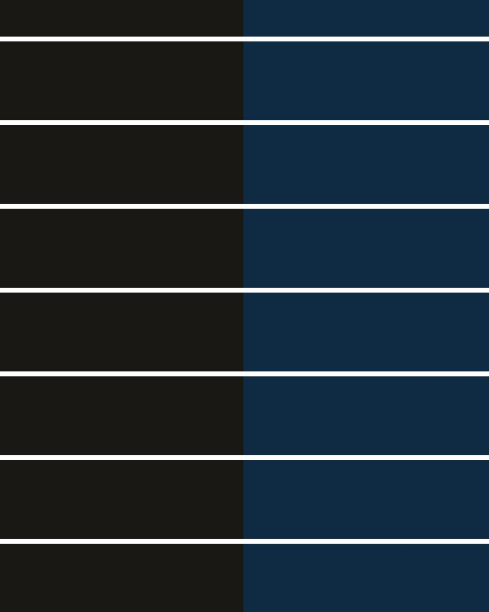
Design

Slide 4
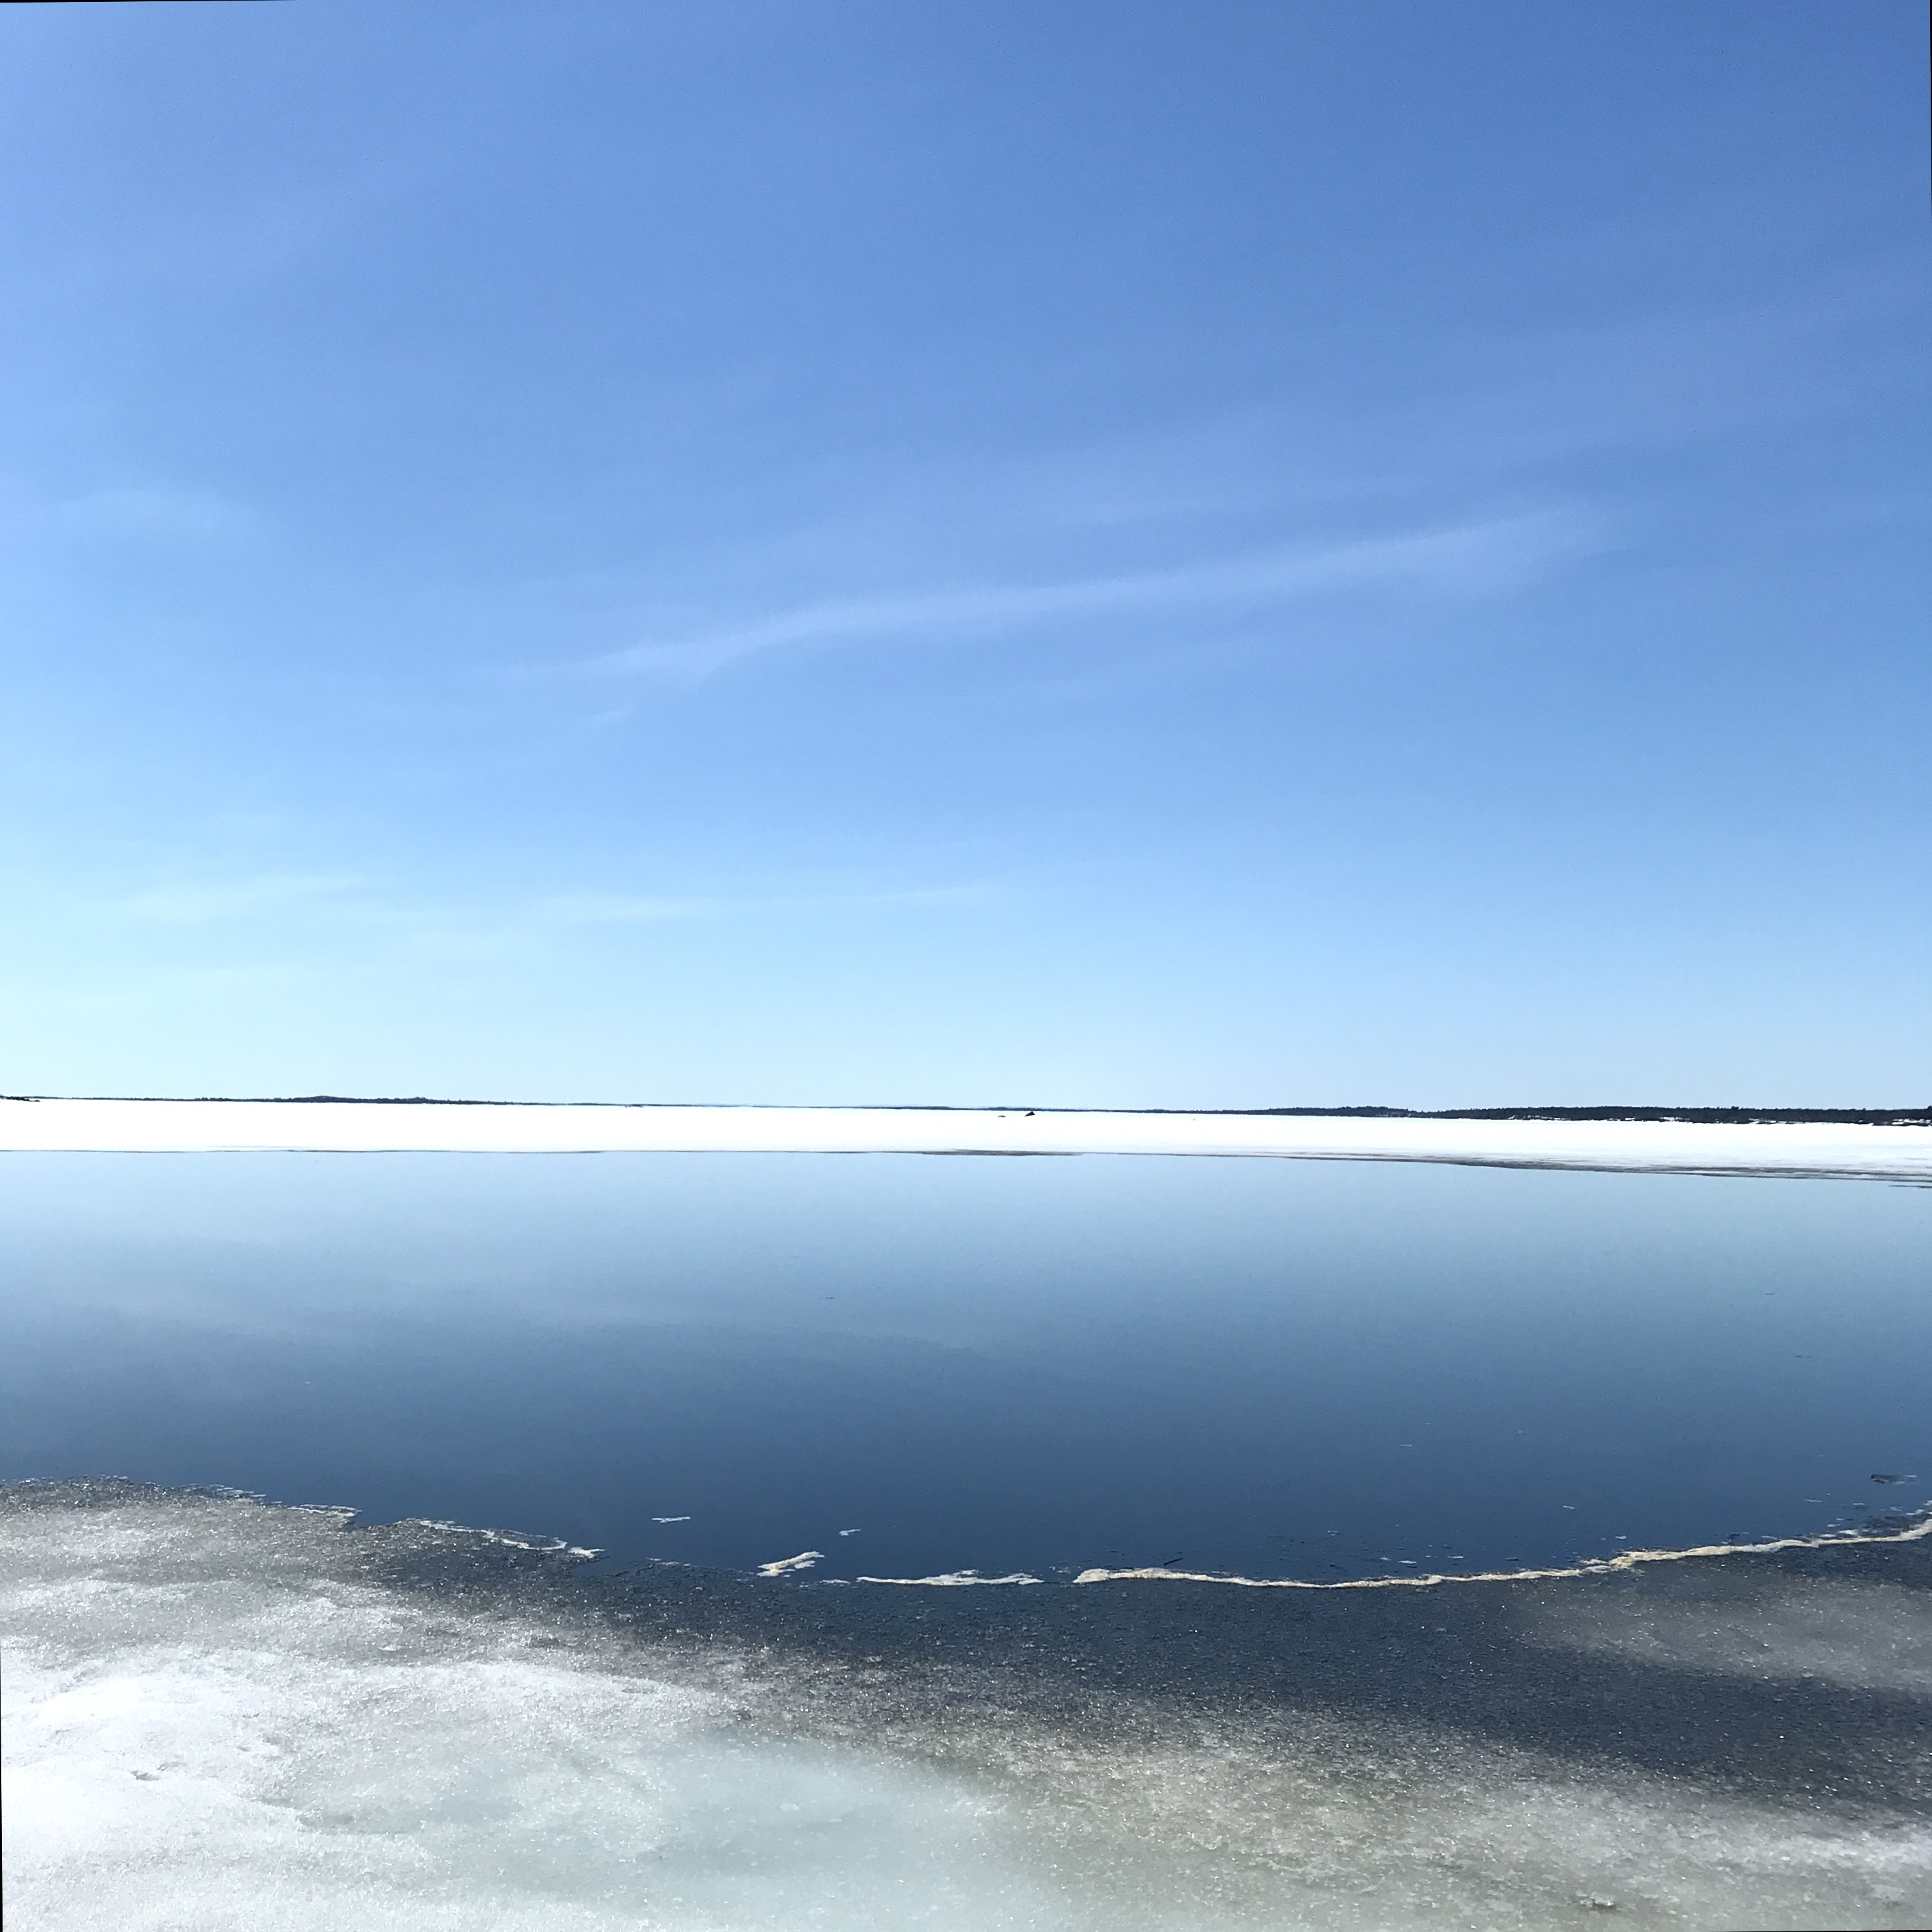
10—11 June 2020
Online EUIPO DEA Jury meeting

Slide 5
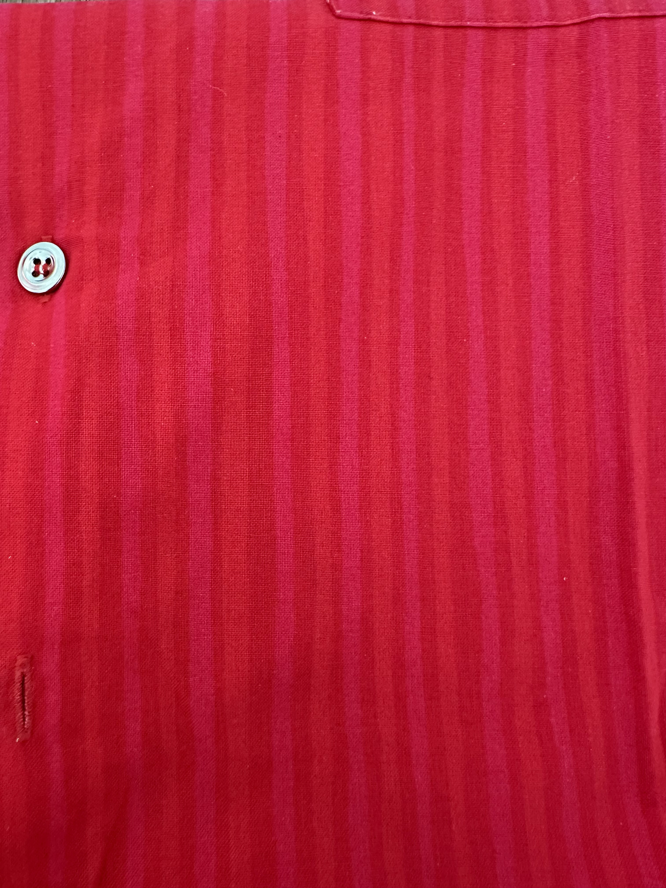
Design protection. What meets the eye.

Slide 6

What doesn’t meet the eye

Slide 7

26 April 2026
EUIPO DEA Jury meeting in Alicante

Slide 8
Design Europa Awards jury, assessment, evaluation, judging
Design protection
Design value

Slide 9
Value frame
Novelty — innovation
Sustainability — regeneration, circularity
Usability, functionality — user needs, user experience
Aesthetics — beauty, form
Ethics — diversity

Slide 10
What doesn’t meet the eye
The judgement — or understanding the value of design in general — is a sum
total of what meets the eye and what doesn’t meet the eye,
an outcome of a dialogue between jury members on what in the end is
weighing a given set of aspects against each other and between,
aspects that stem from the value frame of the society we are part of.

Slide 11
There’s more than meets the eye. Thank you.
EUIPO IP Law Conference 20 May 2026
Päivi Tahkokallio
CEO Tahkokallio Design+
Former President of BEDA, The Bureau of European Design Associations
Director of Proto2026 Design Programme

